Slide 1
VHC Review
Sprint Demo: 06/05/2023

Slide 2
Supplychain > Is like a Brain

Slide 3
Product Vision
For businesses, NGOs, and regulators Who need to assess supply chain sustainability and identify key power players The LLM Automated Supply Chain Analysis System is an AI-powered solution That simplifies the evaluation of supply chain practices and maps stakeholder influence with precision Unlike traditional supply chain assessment tools Our system provides a user-friendly interface with advanced analytics, offering actionable insights for improvement while ensuring data privacy and security. Additionally accessing hard-to-reach data and transparently showing its source to uphold the integrity of the evaluation process.

Slide 4
Product Goal
To Gather evidence for the need for improvement, which is then validated, and then is used to build a case for improvement.
In our pursuit of sustainability within supply chains, we must conquer the complexity of data and make the insights accessible and actionable.
The system we develop must effortlessly map out sustainability metrics and power dynamics, integrating data seamlessly while providing a straightforward user experience.
Our product goal is to enable precise sustainability reporting and stakeholder analysis, providing the clarity needed for companies to enact change. The measure of success will be our system's accuracy and the degree to which it empowers companies to adjust their operations toward more sustainable practices.

Slide 5
Requirements
Data Collection and Integration
Ability to aggregate data from various sources, including IoT devices, ERP systems, and public databases.
Integrate with blockchain platforms to access and verify transaction data.
Stakeholder Identification
AI algorithms to identify and profile stakeholders within the supply chain.
Features to map stakeholders’ roles, influence, and relationships.
Sustainability Assessment
Criteria and metrics for evaluating the sustainability of supply chain practices.
Tools for measuring environmental impact, ethical sourcing, and labor practices.
Power Player Analysis
Analytical tools to identify and assess major power players’ impact on the supply chain.
Visualization of power dynamics and their implications for sustainability and efficiency.
Drill-Down Capability
Detailed breakdowns of product-specific supply chain paths, including subcomponents.
Company-focused analysis, including corporate policies, sustainability reports, and compliance records.

Slide 6
Features
Ingredient Search: Allows users to identify the components required to manufacture a specific product.​
Product Reverse Search: Enables tracing back from a product to its raw materials and their sources.​
Business-to-Product Mapping: This feature allows users to start with a business and then discover all the products it manufactures.​
Supply Chain Mapping: Maps the entire supply chain, identifying all entities involved in the production of a specific product.​
Power Dynamics Mapping: Constructs a map of the relationships and hierarchies among manufacturers, suppliers, and other stakeholders.​
Comparison Feature: Offers the ability to compare similar products and companies, facilitating a broader understanding of the market landscape.​
Environmental Impact Analysis: Utilizes machine learning to detect patterns of pollution, material waste, and logistics inefficiencies within the supply chain.​
Stakeholder Information: Gathers and analyzes information about customers and suppliers related to the same product, aiding in the comprehensive assessment of the supply chain

Slide 7
Sprint Goal
Our focus is on
Sprint Goal Template | Scrum.org

Slide 8
UserStories
What Dashboards: Viewing Supply Chain Maps
Userstory : Setting up a Dashboard
Userstories : Designing Dashboards
Userstories: User Story 1: Data Scientist - Data Collection and Preparation
Userstories: BCM - > Mapping & Design

Slide 9

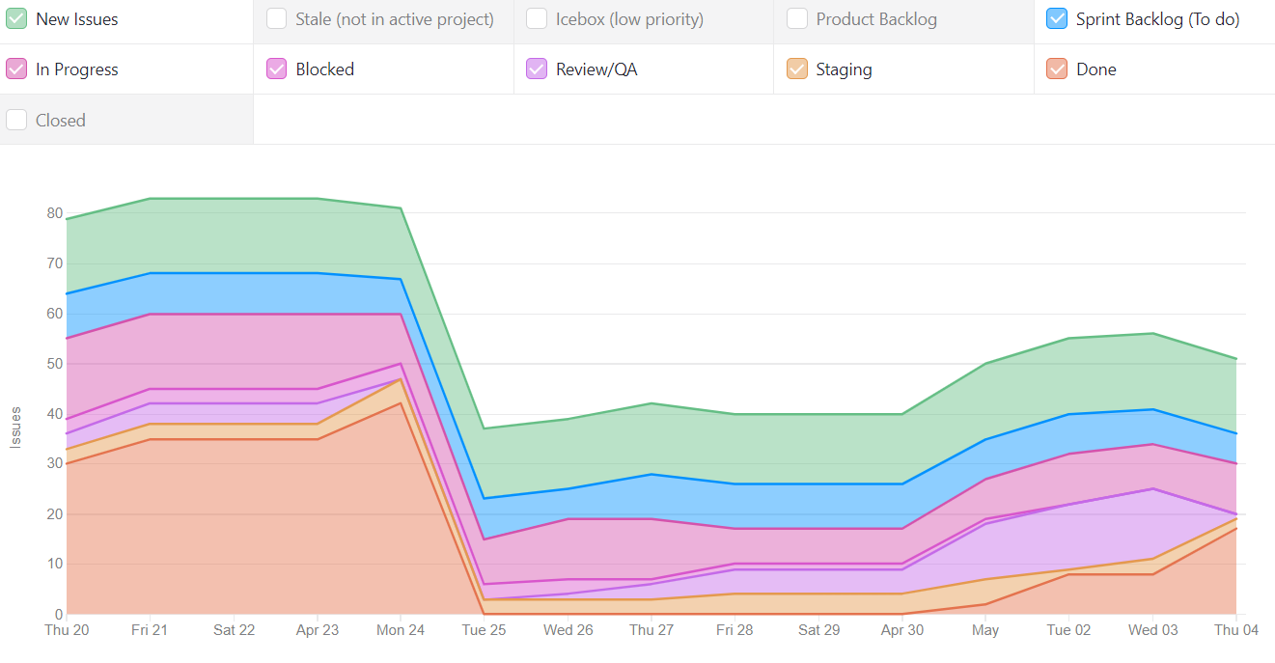
Cumulative Flow

Slide 10
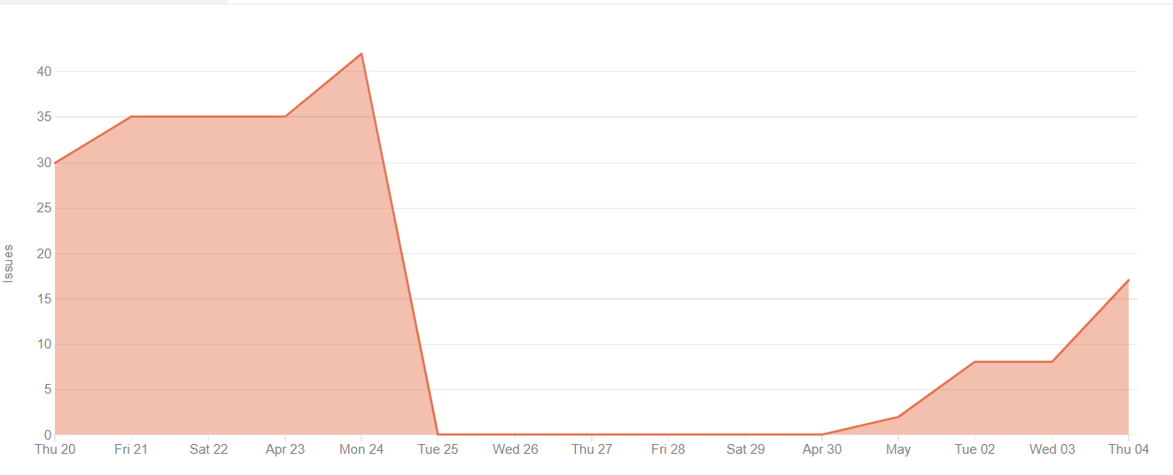
Burnup Chart

Slide 11
Demo
Username shown in the Demo and Login website after login
If the user logs out or cancels during login, they get sent back to demo website with error
Logged in screen on demo

Slide 12
Screenshot of delivered product increment

Slide 13
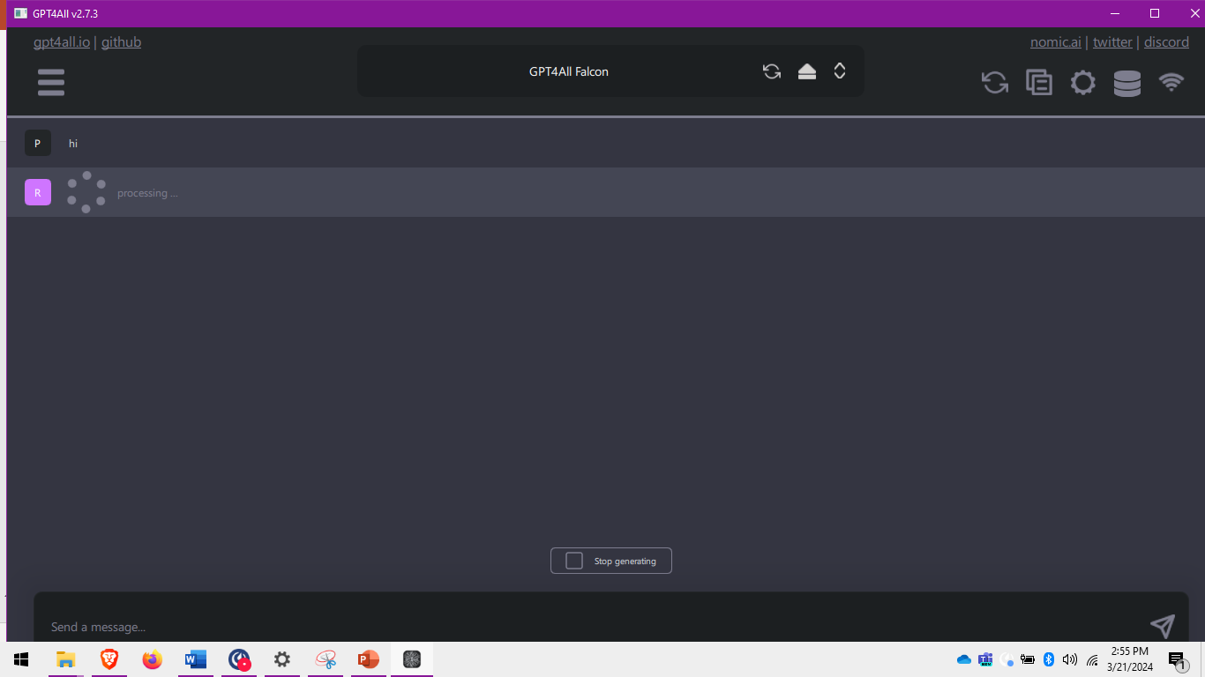
Screenshot of delivered product increment

Slide 14
Next sprint goal
Our focus is on allowing a user to log into the Demo website on desktop web browser
We believe it delivers an essential feature to be able to sign into external applications to users of our clients
This will be confirmed when a user can log into the Demo website running on their desktop computer from their Tonomy ID mobile wallet
After this: demo app, login via mobile, deployment, Tonomy Participate integration, integration with forked open-source, white labelling, change password, IaaS automation, push notifications, responsiveness (Tonomy ID)

Slide 15
Feedback on current demo product from stakeholders
What comes (1-2 words) to your mind when you think of sprint review?
What do you think of the demoed product?
VC flow - JWT/W3C flow goes last, document should go first (pdf)
Overlapping text does not look good
“Username” on screen twice
Spaces should be ignored/trimmed automatically
No feedback to show that you are in the form field
During the SSO log
Should have consent screen for username - figma designs enough

Slide 16
Feedback on priorities and direction
What do you think of our production vision and goals?
SEGMENT web3 we are ready for, ethical industry not ready
Ethical industry not useful unless there are already other apps to log into
Existing Antelope chains have wallet trx singing functional expectations, which Tonomy ID does not yet have
Need to check the SLA, EULA and Privacy Notice
What do you think of the next sprint goal?
Login to Tonomy Participate gives us two products - high priority
Tonomy Participate is showing a “real software”
Change demo.com to look like an NFT market would make an easier conversation
Tonomy Participate has a non-trivial amount of work to integrate

Slide 17
Issues and Blockers – Help Needed from Mgmt
Alignment on the Product Vision and Goal(s)

